Slide 1
Analyzing Quantitative Data
Presented by:
Samiran Mandal,
NITTTR, Kolkata

Slide 2
What is quantitative data?
Quantitative data in raw form, that is, before these data have been processed and analyzed, convey very little meaning to most people.
These data are processed to turn them into information by quantitative analysis techniques such as graphics, charts and statistics and help us to explore, present, describe and examine relationships and trends within our data.

Slide 3
Classify quantitative data?
Quantitative data can be divided into two distinct groups:
Categorical Data - Data whose values cannot be measured numerically but can be either classified into sets according to the characteristics that identify or describe the variable or placed in rank order. They can further sub-divided into.
Descriptive – A car manufacturer might categorize the types of cars it produces as hatchback, saloon estate. It is impossible to define the category numerically or to rank. These data simply count the number of occurrences in each category of a variable.

Slide 4
Classify quantitative data?
b) Ranked (or ordinal) data – They are more precise form of categorical data. The relative position of each case within the data set are known. Rating or scale questions, such as where a respondent is asked to rate how strongly she or he agrees with a statement, collect ranked data.
ii. Numerical data – These values are measured or counted numerically as quantitative and they are more precise than categorical data. These data can be analyzed using a far wider range of statistics. They can be further classified into
Interval data – By this you can state the difference or ‘interval’ between any two data values for a particular variable, but cannot state the relative difference. This means that values on an interval scale can meaningfully be added and subtracted, but not multiplied and divided.

Slide 5
Classify quantitative data?
Example: Although the difference between say 20°C and 30°C is 10°C it does not more that 30°C is one and a half times as warm. This is because 0°C does not represent a true zero.
b) Ratio data – We can calculate the relative difference or ratio between any two data values for a variable.
Example: OF a company makes profit Rs. 300,00,000 in one year and Rs. 600,00,000 the following year, we can say that profits have doubled.

Slide 6
Differentiate between continuous data and
discrete data?
Continuous data can theoretically take any valve (sometimes within a restricted range) provided that you can measure them accurately enough.
Example: furnace temperature, delivery distance and length of service
Discrete data can be measured precisely and each takes one of a finite number of values from a scale that measures changes in discrete units. These data are often are whole numbers (integers) such as the number of mobile telephones manufactured or customers served.

Slide 7
What is data matrix?
All analysis software accepts data if they are entered in table format. This table is called a data matrix. Once data have been entered into your analysis software, it is usually possible to save them in a format that can be read by other software. Within a data matrix, each column usually represents a separate variable for which you have obtained data. Each matrix row curtains the variables for an individual case, that is an individual unit for which data have been obtained.

Slide 8
What is coding?
All data types should, with few exceptions, be recorded using numerical codes and enables you to enter the data quickly using the numeric keypad on your keyboard and with fewer errors. It also makes subsequent analyses in particular those that require re-coding of data to create new variables.

Slide 9
How to code numerical data?
Actual numbers are often used as codes for numerical data, even through this level of precision may not be required. Once you have entered your data as a matrix you can use analyses software to group or combine data to form additional variables with less detailed categories. This process is referred as re-coding.

Slide 10
How to code categorical data?
Codes are often applied to categorical data with little thought, although you can design a coding scheme that will make subsequent analyses for simpler.
For many secondary data sources (such as government surveys), a suitable coding scheme will have already been devised when the data were first collected.

Slide 11
How to code categorical data?
Coding at data collection occurs when there is a limited range of well established categories into which the data can be placed. These are included on data collection form, and the person filling in the form selects the correct category.
Coding after data collection is necessary when you are unclear of the likely responses or there are a large number of possible responses in the coding scheme. To ensure that the coding scheme captures the variety in responses it is Beth to wall until data from the first 50 to 100 cases are available and then develop the coding scheme. This is called the codebook.

Slide 12
What is weighting cases?
Most data we use will be sample. For some forms of probability sampling such as stratified random sampling. We may have to use a different sampling fraction for each structure.
Alternatively we may have obtained a different response rate for each of the strata. To obtain an accurate overall picture we will need to take account of these differences in response rates between strata.
A common method of achieving this is to use cases from those strata that have lower proportions of responses to represent more than one case in your analysis.

Slide 13
What is weighting cases?
Most statistical analysis software allows to do this by weighing cases. To weight the cases we
Calculate the percentage of the population responding for each stratum.
Establish which stratum had the highest percentage of the population responding.
Calculate the weight of each stratum using the following formula.
Apply the appropriate weight to each case.

Slide 14
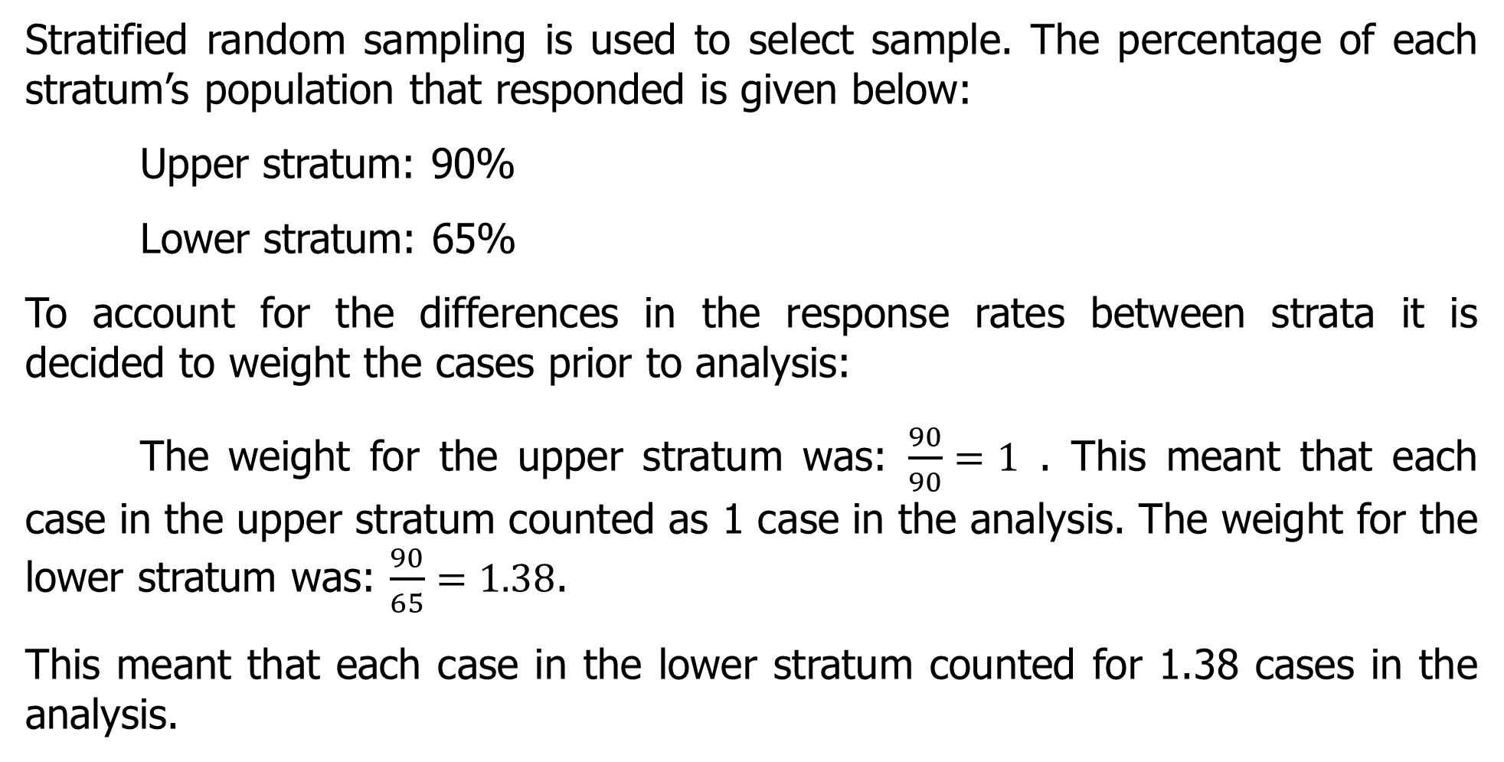
Example of weighing cases?
Stratified random sampling is used to select sample. The percentage of each stratum’s population that responded is given below:
Upper stratum: 90%
Lower stratum: 65%
To account for the differences in the response rates between strata it is decided to weight the cases prior to analysis:
The weight for the upper stratum was: $\frac{90}{90}=1$ . This meant that each case in the upper stratum counted as 1 case in the analysis. The weight for the lower stratum was: $\frac{90}{65}=1.38$.
This meant that each case in the lower stratum counted for 1.38 cases in the analysis.

Slide 15
What is exploratory data analysis?
Once data have been entered and checked for errors, data analysis can be started. Exploratory data analysis approach is useful in these initial stages which emphasis the use of diagrams to explore and understand data, exphassing the importance of using the data to guide choices of analysis techniques.
Exploratory analysis is best to begin by looking at individual variables and their components. The key aspects need to consider guided by research question and objectives include:
Specific values.
Highest and lowest values.
Trends over time.
Proportions.
Distributions.

Slide 16
How to show specific values of individual variables?
The simplest way of summarizing data for individual variables so that specific values can be read is to use a table (frequency distribution).
For categorical data, the table summarizes the number of cases (frequency) in each category.
For variables where there are likely to a large number of categories (or values for numerical data) you will need to group the data into categories the reflect your research question(s) and objectives.

Slide 17
How to show highest and lowest values?
Diagrams can provide visual clues, although both categorical and numerical data may need grouping. For categorical and discrete data, bar charts and pictograms are both suitable.
Generally bar charts provide a more accurate representation and should be used for research reports, whereas pictograms convey a general impression and can be used to gain an audiences attention.
In bar chart, the height or length of each bar represents the frequency of occurrence. Bars are separated by gaps, usually half the widths of the bars.

Slide 18
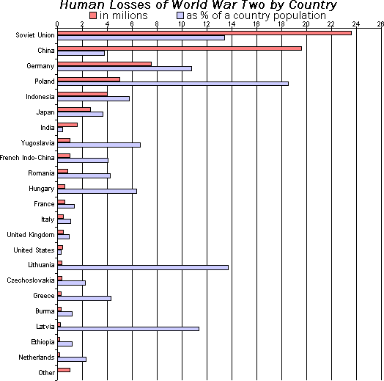
Example of Bar diagram

Slide 19
How to show highest and lowest values?
To emphasize the relative values represented by each of the bars in a chart, the bars may be reordered in either discording or according order of the frequency of occurrence represented by each liar.
Most researchers use a histogram to show highest and lowest values for continuous data. Prior to being drawn, data will often need to be grouped into class intervals.
In a histogram, the area of each bar represents the frequency of occurrence and the continuous nature of the data emphasized by the absence of gaps between the bars.

Slide 20
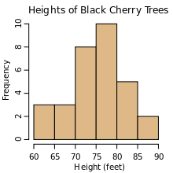
An example histogram of the heights of 31 Black Cherry trees

Slide 21
What is a pictogram?
In a pictogram, each bar is replaced by a picture or series of pictures to represent the data.
Pictures in pictograms can, like bars in bar charts and histograms, be shown in columns or horizontally. The height of the column or length of the bar made up by the pictures represents the frequency of occurrence.

Slide 22
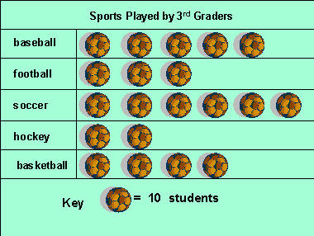
An example of pictograph

Slide 23
How to show a trend?
Trends can only be presented for variables curtaining numerical longitudinal data: The most suitable diagrams for exploring the trend is a line graph in which data values for each time period are joined with a line to represent the trend.

Slide 24
Line Graph
A line graph has two axes. The x-axis of a line graph shows the occurrences and the categories being compared over time and the y-axis represents the scale, which is a set of numbers that represents the data and is organized into equal intervals

Slide 25
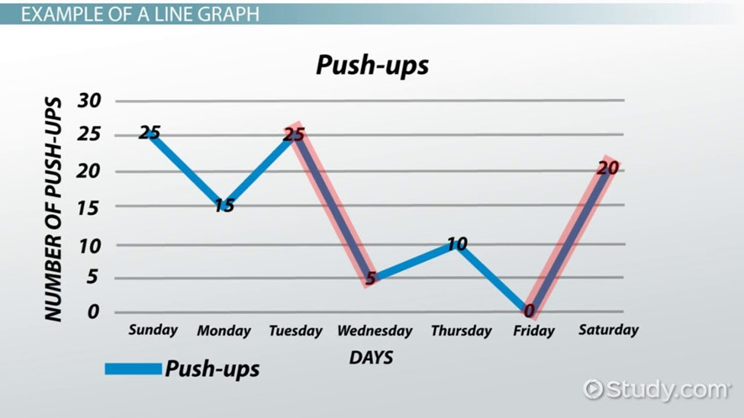
An Example of a Line graph

Slide 26
How to show proportions?
The most frequently used diagram to emphasize the proportion or share of occurrences is the pie chart, although bar charts have shown to give equally good results.
A pie chart is divided into proportional segments according to the share each has of the total value.
For numerical and some categorical data it is needed to group data prior to drawing the pie chart; as it difficult to interpret pie charts more than six segments.

Slide 27
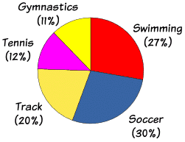
Pie chart
A pie chart (or a circle chart) is a circular statistical graphic, which is divided into slices to illustrate numerical proportion.
In a pie chart, the arc length of each slice (and consequently its central angle and area), is proportional to the quantity it represents.
Start at 12.00 with the largest and most important segment,go clockwise in logical order, keep no. of segments 5 or at the most 7,label segments outside the circle

Slide 28
How to show distribution of values?
Prior to using statistical tests it is necessary to establish the distribution of values of variables curtaining numerical data. This can be seen by plotting either a frequency polygon or a histogram for continuous data or a frequency polygon or bar chart for discrete data.
If the diagram shows polygon or bar chart for discrete data a long tail to the night as the data are to the left and a long tail to the night are positively skewed. If convenes is true the data are negatively skewed.

Slide 29
How to show distribution of values?
If data are equally distributed either side of the highest frequency then they are symmetrically distributed.
A special form of the symmetric distribution, in which the data can be plotted as a bell shaped curve, is known as the normal distribution.

Slide 30
Thank you

